Slide 1
Welcome
Put First Things First
Notes:
In every slide, ask the audience before you conclude

Slide 2
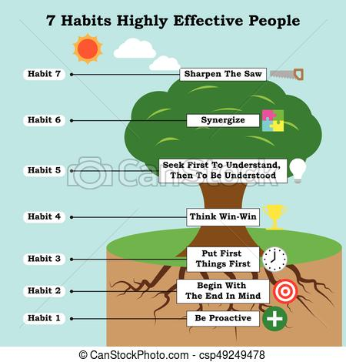

Slide 3
Habits
Habit -1 : Be Proactive : Focus Time and Energy on things that can be controlled
Habit -2 : Begin with the End in Mind
Have Goals and road map

Slide 4
Take a Paper
Write 12 activities / Goals / wanted to have or achieve in another 5 years / everyday activities
Segregate Important, urgent, not important, not urgent

Slide 5
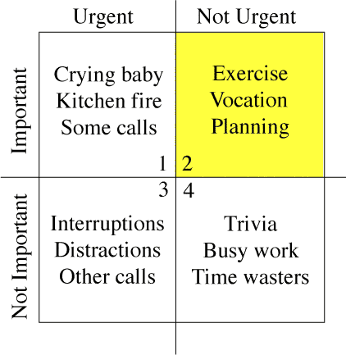
Put First Things First

Slide 6
First Quadrant – Results / Impacts(Important and Urgent)
Stress and Anxiety
Feeling Burnt Out
Mediocore performance

Slide 7
Q3-Quadrant Results /Impacts (Not Important but Urgent)
Feeling like a Follower rather than a Leader
Lack of Discipline
Feeling like a doormat for others to wipe their feet on

Slide 8
Quote for Q3 quadrant
I Don’t know the key to success, but the key to failture is to try pleasing everyone

Slide 9
Q4-Not Important and Not Urgent
Slacker
Waste
Results of this
Lack of responsibility
Guilt feel
Missing out on adventures

Slide 10
Q4
Example
Filling Petrol in the Car and Two wheeler
Not Urgent, but if you forget…

Slide 11
Q2 – Important but not Urgent
It is Important but not Urgent
Can you specify in this list

Slide 12
Q2 People
Know how to say “NO”
Results
Control of your Life
Balance
High Performance

Slide 13
Put First Things First
Shrink Q1 (Urgent and Important)
Say “no” to Q3 (Urgent and N.Imp)
Cut down activities in Q4(NU / NI)
Increase time in Q2(Imp but not Urg)

Slide 14
Why Plan?
No Need to Remember
You can prioritize
You know pending things
You will have clarity to allocate time

Slide 15
How to Plan well?
Make a role wise plan
As a Student – What you have to do?
As a Family person/son/brother – What you have to do?
As a Friend – what you have to do?
As a Citizen – what you have to do?

Slide 16
Plan
Weekly Plan is best
Daily Plan-too narrow to track
Monthly Plan – too broad to focus

Slide 17
Differentiate the Rocks
You can ask them to view the video (copy paste in the chat box)
https://www.youtube.com/watch?v=zV3gMTOEWt8
Big Rocks
Small Rocks

Slide 18
Ask them what are there BIG rocks/stones

Slide 19
Time Management is Life Management
Only Two things you cannot recycle
Time
Life (atleast with available knowledge, don’t know about incarnations and new lives)

Slide 20
Habit-3
After time management, it talks about FEAR
Help to overcome fear
Help to over come peer pressure

Slide 21


Slide 22
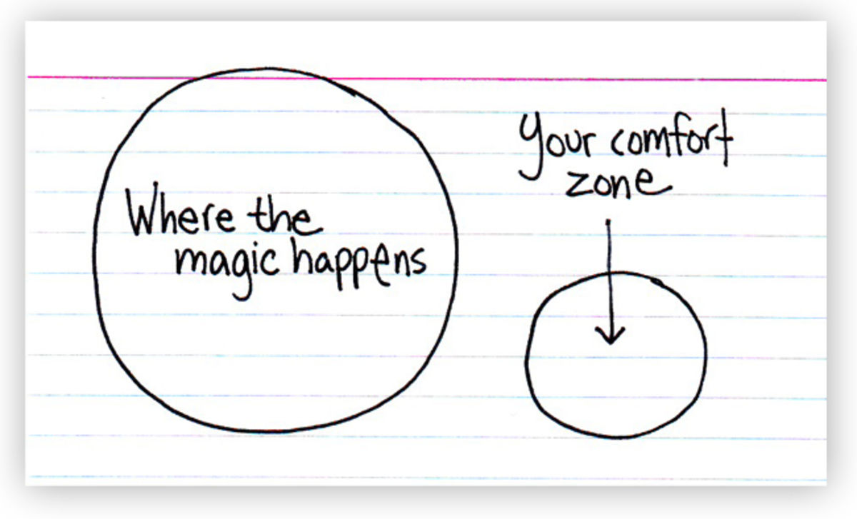

Slide 23
Who Decide?
Never let your fears make your decisions, you make them
All Leaders had fears, but the decisions they took, not the fears
Eg. Gandhi, Nelson Mandela, all sports people, all public speakers, singers, dancers

Slide 24
Feel the fear
Not the problem, but do it anyway.
Winning is nothing more than rising each time you fall

Slide 25
Peer Pressures
Consider, but don’t get pressured
Let them think/ask/request/command, but you do as per your limits/speed
Ignore Gossips
Ignore others opinions

Slide 26
The Common Ingredient of Success
For every successful person is
DISCIPLINE

Slide 27
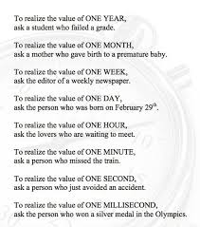
The Value of Time

Slide 28
Baby Steps
Identify time wasters
Check your “yes”es
What are all you are postponing?
What are all you have postponed till today?
What are your fears?
What are your peer pressures?

Slide 29
Screen shot out time
Attendance

Slide 30
Attendance time

